Slide 1
Introduction to Docker
Lecture 1 (INT 332) BASICS OF DEVOPS
Revolutionizing Containerization

Slide 2
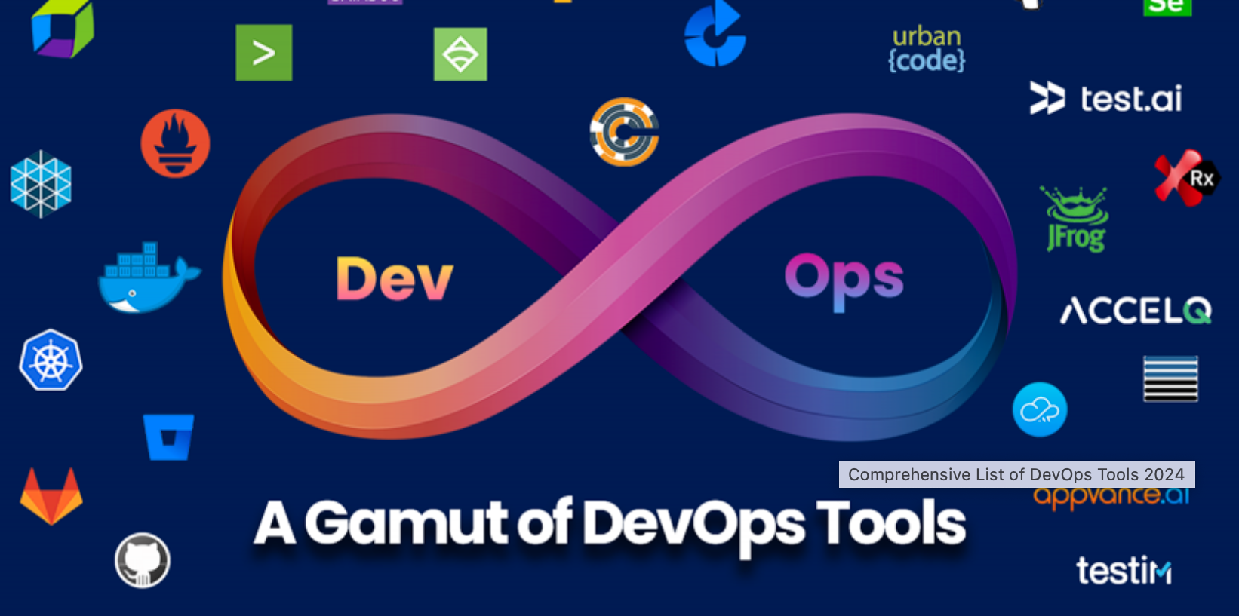
Why Devops

Slide 3
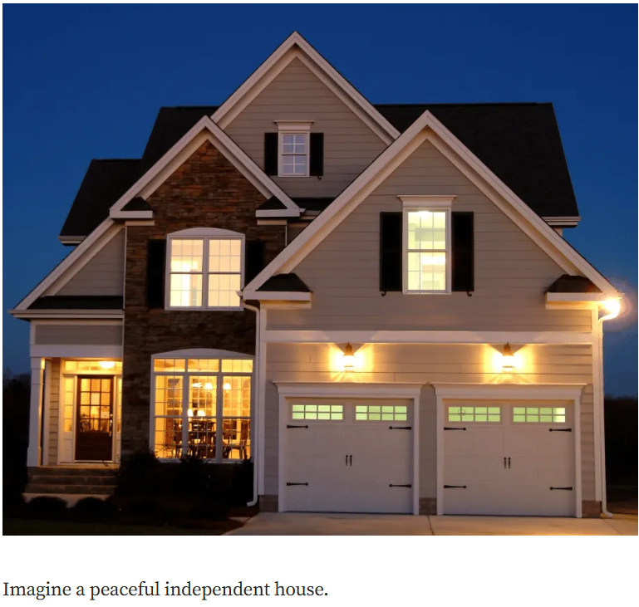
Understanding the concepts of Virtulization and Containerization
Notes:
One house = One physical server
All resources (electricity, water, rooms) are shared
Only one family can comfortably live there
🔴 Problem in IT: Running only one application per server wastes resources and increases cost.

Slide 4
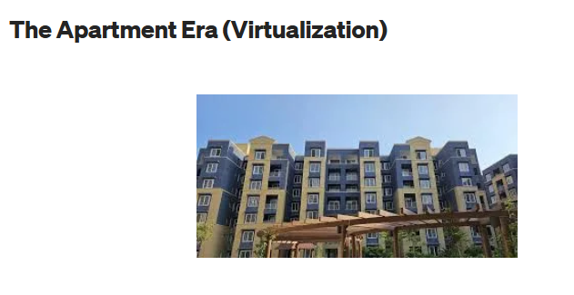
Notes:
Its own walls
Separate rooms
Independent utilities
💻 Technical Meaning
In DevOps, Virtualization means:
One physical server runs multiple Virtual Machines (VMs)
Each VM has:
Its own Operating System
Its own applications
A Hypervisor manages all VMs
✅ Advantages
Strong isolation
Can run different OS (Linux, Windows)
Better hardware utilization than single server

Slide 5
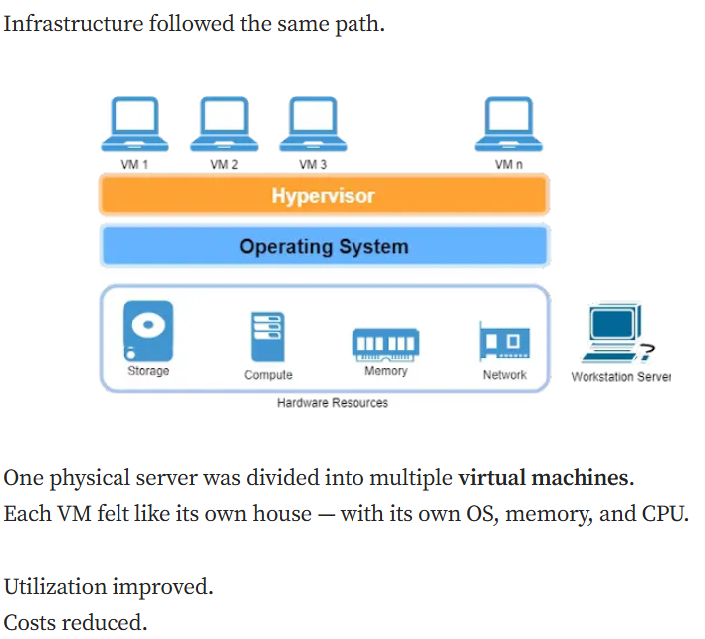

Slide 6
Virtualization and containerization
Virtualization
With the changing times, businesses started looking for solutions to reduce overhead costs, enhance scalability, and standardize application deployment process.
They started considering the following two approaches to reduce costs −
Virtualization
Containerization

Slide 7
What is Virtualization?
Virtualization is the process of partitioning a physical server into multiple virtual servers.
The process of partitioning is carried out using a software called 'hypervisor'.
After partitioning, the virtual servers act and perform just as a physical server.
Essentially, it means using the same hardware set-up more efficiently, thereby freeing the resources for other tasks or retiring the resources altogether.

Slide 8
Advantages of Virtualization
Enhanced performance
Promotes agile IT infrastructure
Promotes use of resources in optimum manner
Better disaster management if any physical hazards take place to resources
Better security as the infected VM can be isolated from other VMs and the host server
Space saving
The capital investment cost on hardware is saved, and thereby maintenance cost is saved, hence overall cost savings for a business.

Slide 9
Drawbacks of Virtualization which lead to concept of containerization
Heavy Resource Overhead
Slow Boot Time and Poor Agility
Inefficient Scalability
Limited Application Portability
Higher Management and Maintenance Complexity
Increased Infrastructure Cost
These drawbacks directly led to the evolution of containerization, which offers lightweight isolation, faster deployment, better portability, and seamless integration with DevOps and microservices architectures.

Slide 10
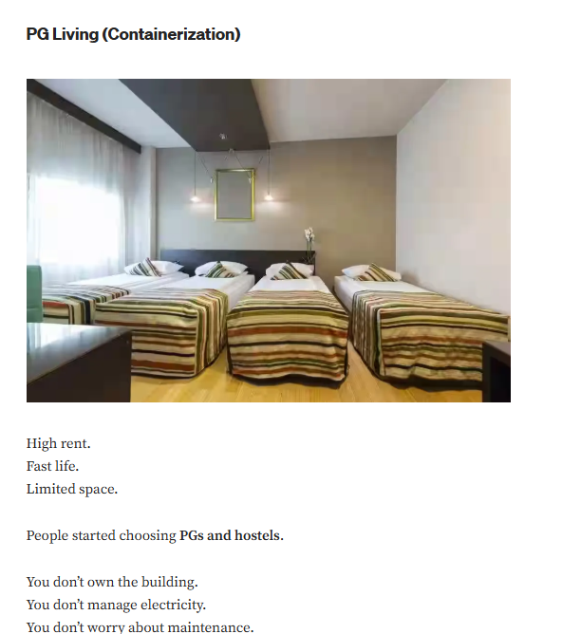

Slide 11
That’s exactly what containers do.
Containers don’t carry an entire operating system. They use bare minimum OS.
They share the host OS and only bring what the application needs.
They start in seconds. They consume minimal resources.
You can run dozens — even hundreds — on the same machine.
Earlier the applications were monolithic , so physical servers were apt,
later there were components split like backend, frontend, db ,so VM’s took care of hosting.
Now all the applications are turning to microservices, so the containerization tools like docker will serve the purpose.
Also the portability problem is also solved using the containerization

Slide 12
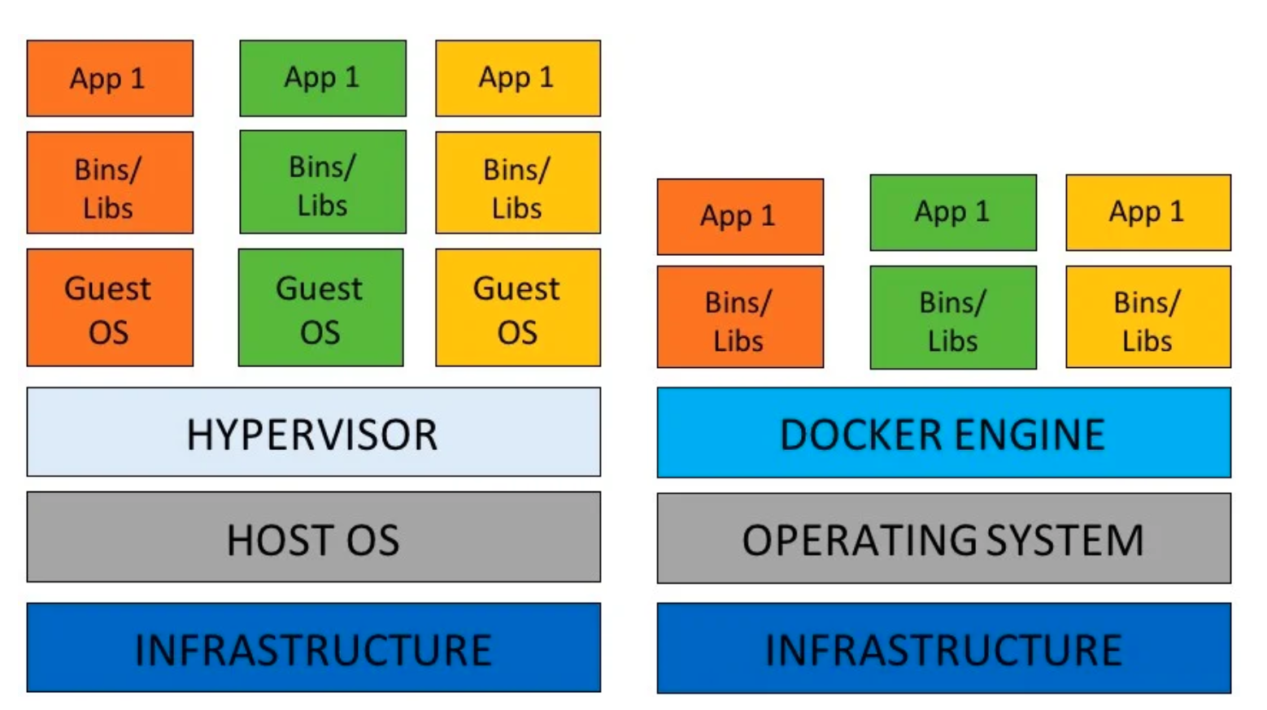
Need of containers

Slide 13
Container Runtime
A container runtime is the software responsible for creating, starting, stopping, and managing containers on a host system.
It acts as the execution engine that turns a container image into a running container.
In simple words:
“Container runtime is what actually runs containers.”

Slide 14
Need for Container Runtime
A container image is just a read-only package (application + dependencies).
To run it, the system needs a runtime to:
Create an isolated environment
Apply resource limits
Start the application process
Monitor and stop it when required

Slide 15
Types of Container Runtimes
1. High-Level Runtimes
Used by users and DevOps tools.
Docker Engine
containerd
CRI-O (Kubernetes-focused)
These handle:
Image pulling
Networking
Storage
Container lifecycle

Slide 16
2. Low-Level Runtimes
Responsible for actually running the container process.
runc (OCI-compliant)
These directly interact with:
Linux kernel
Namespaces
cgroups

Slide 17
Real-World Analogy
Container Image → Packed lunch box
Container Runtime → Person who opens it, serves food, and cleans up

Slide 18
Process Isolation & Namespaces
Process isolation ensures that each container runs as if it is alone on the system, even though multiple containers share the same OS kernel.
This isolation is achieved using Linux namespaces.

Slide 19
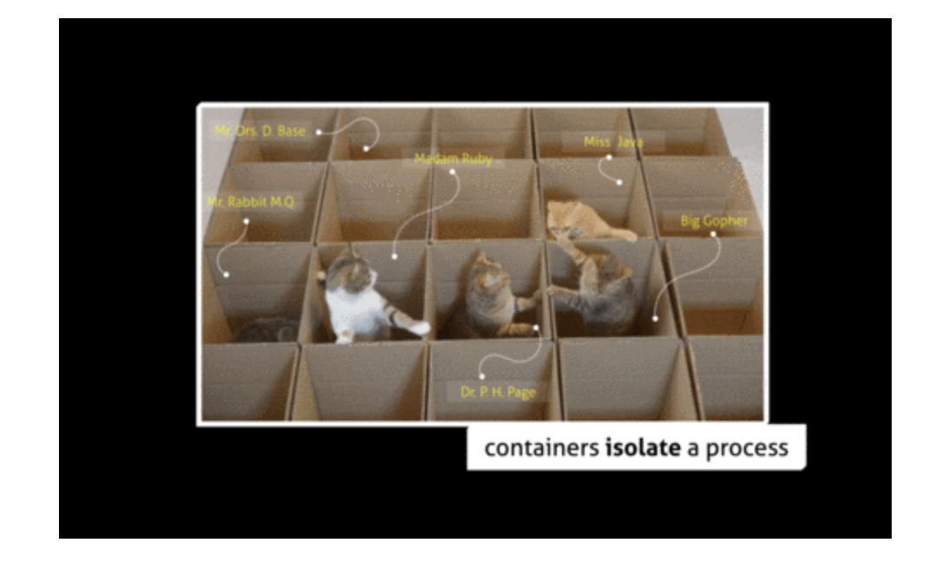

Slide 20
Interpretation of Picture
As shown is this little cat picture, containers are isolated but using networking they still discover each other and consume the services if needed.

Slide 21
Namespaces
Namespaces are Linux kernel features that partition system resources so that processes see only what belongs to them.
“Namespaces create the illusion of a separate system for each container.”

Slide 22
Namespaces Used in Containers
PID Namespace (Process Isolation)
Each container has its own process tree
Process IDs inside container start from 1
A container cannot see host or other container processes
Scenario: Web Application Container
Suppose you run a Python-based web service inside a container.
App (PID 1) → main application (web server)
├── worker-1 → handles client requests
├── worker-2 → handles client requests
└── logger → writes logs to files/stdout

Slide 23
2. Network Namespace
Each container gets:
Its own IP address
Its own ports
Containers can run apps on the same port without conflict
Example: Multiple Nginx containers all listen on port 80 internally.
Container 1: 172.17.0.2:80 → Nginx
Container 2: 172.17.0.3:80 → Nginx
Container 3: 172.17.0.4:80 → Nginx

Slide 24
3. Mount Namespace
Each container has its own filesystem view
File changes inside container do not affect host
4. UTS Namespace
Allows each container to have its own hostname
5. User Namespace (Advanced)
Maps container users to non-root users on host
Improves security

Slide 25
Real-World Analogy behind Namespaces
Namespaces are like separate cabins in a train:
Same engine (kernel)
Different passengers
No visibility between cabins

Slide 26
Control Groups (cgroups) for Resource Limits
Control Groups (cgroups) are Linux kernel features that limit, control, and monitor resource usage of processes.
They ensure that:
No container can monopolize system resources
Fair sharing of CPU, memory, and I/O
“Namespaces isolate, cgroups control.”

Slide 27
Need of cgroups
Without cgroups:
One container could consume all CPU or RAM
Host and other containers could crash

Slide 28
Types of Resources Controlled by cgroups
1.CPU
Limit CPU usage
Assign CPU shares
2. Memory
Set maximum memory usage
Kill container if limit exceeded
3. Disk I/O
Limit read/write speeds
4. Network (Indirectly)
Through traffic shaping mechanisms

Slide 29
Real-World Analogy
cgroups are like electricity meters in apartments:
Each flat has a limit
One tenant cannot use all power

Slide 30
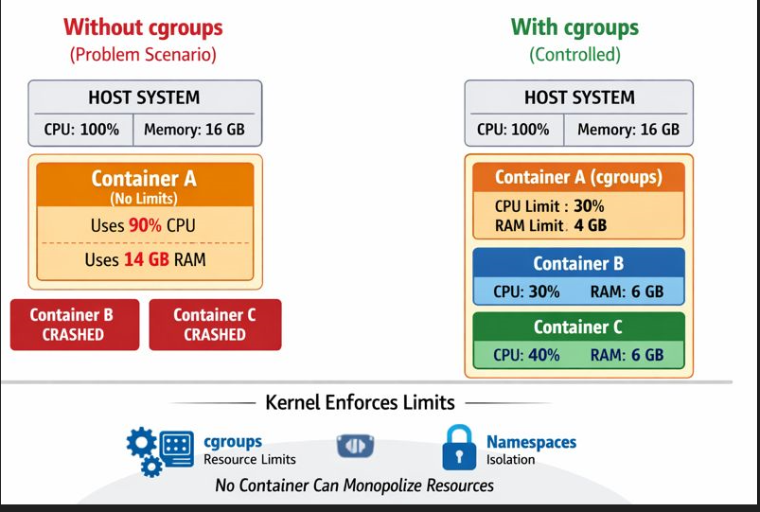

Slide 31
Today’s Task
Task 1: A company uses containers for microservices. One faulty container crashes the host due to high memory usage.
Questions:
Which container feature was misconfigured or missing?
Which kernel mechanism should have prevented this?
Would namespaces alone solve this issue? Why?

Slide 32
Task 2: A server is running three containers:
Container A runs a CPU-intensive task
Container B runs a web server
Container C runs a database
Questions:
Which Linux feature prevents Container A from consuming all CPU?
Which feature ensures Container B cannot see processes of Container C?
Which namespace allows all three containers to use port 80 internally?

Slide 33
Container Image
A container image is:
A read-only blueprint
Contains:
Base OS (minimal)
Application code
Libraries & dependencies
Runtime
Configuration
Images are immutable – once built, they do not change.

Slide 34
Example
python:3.11-slim is the image
This image already includes:
Linux OS
Python 3.11
Standard Python libraries

Slide 35
Image Layers
Each image is built as a stack of layers.
Characteristics of Layers
Each instruction in a Dockerfile = one layer
Layers are:
Immutable
Cached
Reused across images

Slide 36
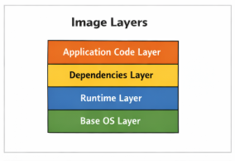

Slide 37
Benefits of Layered Images
Faster Builds
Docker reuses unchanged layers (cache)
Smaller Storage
Same layers shared between images
Faster Deployment
Only missing layers are downloaded

Slide 38
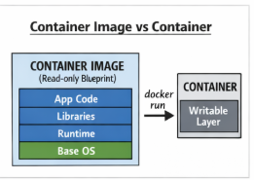

Slide 39
Image Registry
An image registry is a centralized repository used to store, manage, version, and distribute container images.
It enables:
Sharing images across teams and environments
Consistent deployment in development, testing, and production
Integration with CI/CD pipelines
In DevOps, an image registry plays the same role as:
GitHub → for source code
Maven Central → for Java libraries

Slide 40
Why Image Registries are Required
Without a registry:
Each system must build images independently
High inconsistency across environments
Manual software installation
No version control of application environments
With a registry:
Build once, deploy everywhere
Faster deployments
Version-controlled environments
Rollback capability

Slide 41
Types of Image Registries
3.1 Public Image Registries
Public registries allow open access to images.
Characteristics:
Images are publicly visible
Anyone can pull images
Often free
Used for base images and open-source applications

Slide 42
Private Image Registries
Private registries restrict access using authentication and authorization.
Characteristics:
Secure and controlled access
Used in enterprises
Stores proprietary applications
Integrated with IAM and RBAC
Examples:
AWS Elastic Container Registry (ECR)
Azure Container Registry (ACR)
GitHub Container Registry (GHCR)
On-premise private registry

Slide 43
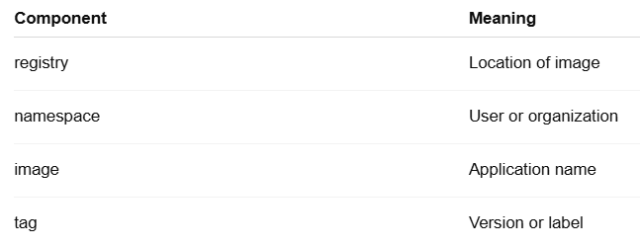
Image Naming Convention
Images follow a standard naming
format:<registry>/<namespace>/<image>:<tag>
Example:docker.io/manpreet/webapp:v1

Slide 44
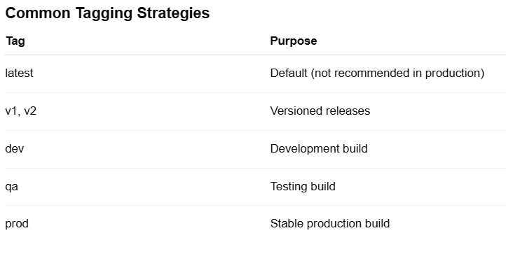
. Tags and Versioning
Tags identify different versions of the same image.

Slide 45
Image Distribution Process
Image distribution refers to how images move from developers to production systems.
Distribution Flow:
Developer builds an image locally
Image is pushed to a registry
Registry stores the image securely
Servers pull the image when required
Containers are created from the image

Slide 46
Push and Pull Operations
Push Operation
Uploads image layers from local system to registry
Requires authentication
Only new layers are pushed
Pull Operation
Downloads image layers from registry
Uses caching to avoid re-downloading existing layers
Faster on repeated deployments

Slide 47
Role of Image Registries in CI/CD Pipelines
In modern DevOps pipelines:
Code is committed to Git
CI system builds the container image
Image is pushed to registry
CD system pulls the image
Application is deployed automatically
In Actual, Registry acts as the bridge between CI and CD.

Slide 48
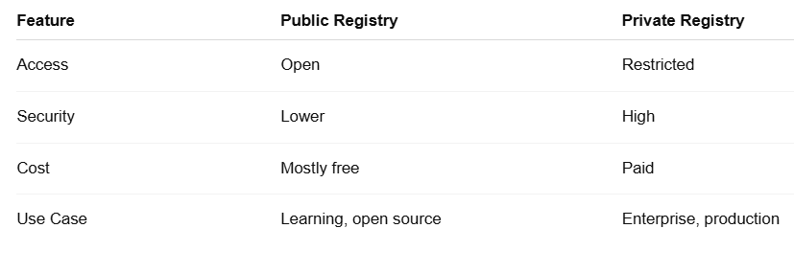
Comparison Between Public and Private Registry

Slide 49
QUIZ
1.What is the primary purpose of an image registry?
A. To execute containers B. To store and distribute container images C. To build container images D. To monitor container performance
2. Which component of an image name represents the version of the image?
A. Registry B. Namespace C. Image name D. Tag

Slide 50
3. Which type of image registry is typically used in enterprise environments?
A.Public registry B. Open registry C. Private registry D. Anonymous registry
4. In CI/CD pipelines, the image registry mainly acts as:
A. Source code repository B. Testing environment C. Bridge between CI and CD D. Container runtime

Slide 51
Introduction to Docker Hub
Centralized repository for Docker images
Features:
Public and private repositories
Official images
Automated builds
Importance in DevOps

Slide 52
Docker Architecture
Key Components:
- Docker Client
- Docker Daemon
- Docker Images
- Containers
- Docker Registry (Docker Hub)

Slide 53
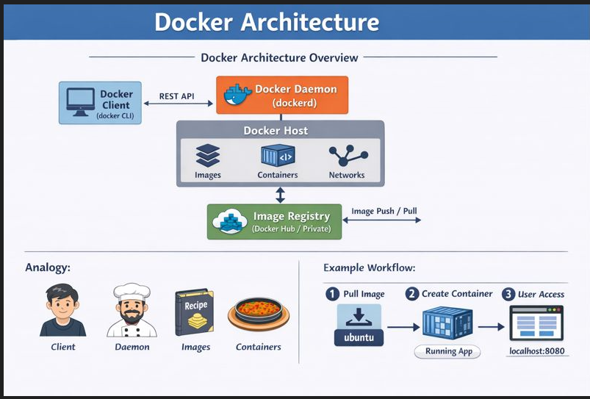

Slide 54
Docker Life Cycle
Stages:
- Build: Create an image
- Ship: Share images via Docker Hub
- Run: Start containers
Container states:
- Created
- Running
- Paused
- Stopped

Slide 55
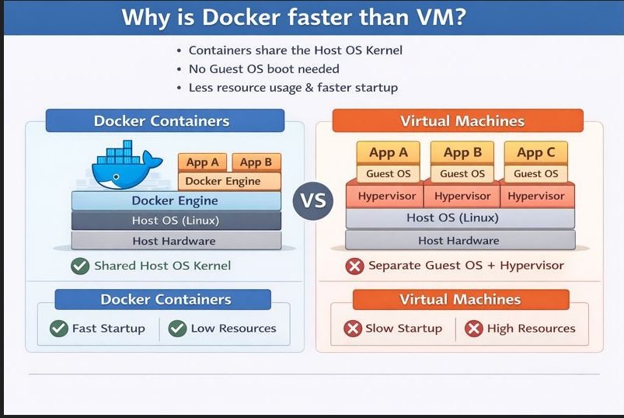

Slide 56
Quick Start
docker pull ubuntu → Downloads the Ubuntu image from Docker Hub
docker images → Lists all downloaded images
docker run ubuntu → Creates and runs a container from the Ubuntu image
docker run -it ubuntu /bin/bash → Runs Ubuntu with terminal access
docker stop <container_id> → Stops a running container
docker rm <container_id> → Removes a container
docker rmi ubuntu → Deletes the Ubuntu image
docker system prune -a → Cleans unused containers, images, and networks
docker system prune -a –volumes → Nuclear Clean

Slide 57
docker pull nginx
docker run -d -p 8080:80 --name mynginx nginx
docker ps
docker stop mynginx
docker start mynginx
docker rm -f mynginx
docker rmi nginx

Slide 58
Container Interaction Commands
docker exec -it <container_id> bash -Opens terminal inside a running container.
docker logs <container_id>-Shows container output logs.
docker inspect <container_id>- Displays detailed configuration in JSON format.
docker stats-Shows live CPU, memory usage of containers.
docker top <container_id>Displays running processes inside container.
docker run -dit --name myubuntu ubuntu
docker start ubuntu

Slide 59
Volume Commands
docker volume create myvolume-Creates a persistent storage volume.
docker volume ls-Lists all volumes.
docker volume inspect myvolume-Shows volume details.
docker volume rm myvolume-Removes a volume.

Slide 60
Network Commands
docker network ls-Lists available Docker networks.
docker network create mynetwork-Creates a custom network.
docker network inspect mynetwork-Shows network details.
docker network rm mynetwork-Deletes a network.

Slide 61
Cleanup Commands
docker stop $(docker ps -aq)-Stops all containers.
docker rm $(docker ps -aq)-Removes all containers.
docker rmi $(docker images -q)-Deletes all images.
docker system prune –a-Cleans unused containers, networks, images.

Slide 62
A student wants to practice Linux commands inside Docker. Run an Ubuntu container in interactive mode using bash and exit safely after execution. Write the commands used to create and access the container.
docker run -it ubuntu bash
exit

Slide 63
You need to troubleshoot a running container by entering its terminal and checking logs. Write commands to:
Open bash inside container
View logs
Show running processes
docker exec -it <container_id> bash
docker logs <container_id>
docker top <container_id>

Slide 64
Create a custom Docker network named mynetwork and verify its configuration. Write commands to create, list, and inspect the network.
docker network create mynetwork
docker network ls
docker network inspect mynetwork

Slide 65
Task
You are a DevOps trainee and need to deploy the Apache HTTP Server (httpd) using Docker for testing a static website. Pull the Apache server image from Docker Hub, create a container named apache-web, and run it in detached mode. Map port 8081 on the host machine to port 80 inside the container so that the website can be accessed through a browser.
Tasks:
Pull the Apache (httpd) Docker image.
Verify that the image is successfully downloaded.
Run the container with the specified name and port mapping.
Check the list of running containers.
Access the Apache web server using a browser.

